Slide 1
MAS T2
The Master of Advanced Studies ETH in Architecture and Digital Fabrication is a one-year full time educational program positioned within a vibrant multidisciplinary research environment. Jointly organised by the Chair for Digital Building Technologies and Gramazio Kohler Research it enjoys strong links with the Institute of Technology in Architecture (ITA) and the Architecture Department (D-ARCH) of ETH Zurich. Furthermore, the MAS is the educational program of the National Centre for Competence in Research (NCCR) Digital Fabrication, one of the biggest and world leading interdisciplinary research clusters on digital fabrication and robotics in architecture.
​ The MAS ETH in Architecture and Digital Fabrication teaches advanced methods and technologies at the forefront of digital design and fabrication and their implementation in architecture and construction. With a focus on computational design, robotic fabrication and 3D printing, projects and assignments enable students to develop strong design concepts and realize large-scale prototypes using the unique robotic construction facilities and 3D printing laboratories at ETH Zurich. Courses are designed not only to teach a thorough understanding of computation and digital fabrication in architecture but also to foster students’ understanding of how new technologies, materials and processes contribute to an advanced and sustainable construction culture.
https://www.masdfab.com/
MAS Pavilions
Every year, the MAS Digital Fabrication realizes two full-scale pavilions, to teach the students the challenges and opportunities of applying digital fabrication in practice. The pavilions are fabricated using various cutting-edge fabrication technologies that are currently being researched at Gramazio Kohler Research and Digital Building Technologies.
Selected previous MAS Pavilions
Robotic Pavilion (2016)
Gradual Assemblies (2018)
Concrete Choreograhpy (2019)
Up Sticks (2019)
Rapid Clay Formations (2020)

Slide 2
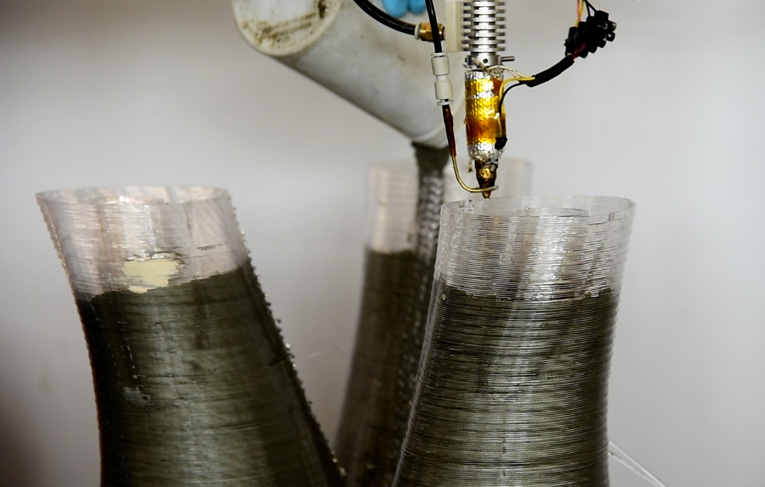
Eggshell
The 2022 MAS Pavilion will make use of the ‘Eggshell’ fabrication technology, currently being researched at Gramazio Kohler Research. Eggshell combines robotic 3D printing with casting of a fast-hardening concrete. By using 3D printing to fabricate the formwork, complex, non-standard elements can be fabricated in an efficient, sustainable process.
Because of the high design freedom that can be achieved, material-efficient, optimized structures can be fabricated. Previous prototypes have shown that it is possible to achieve a material reduction of 50% with this technology.
Links
https://gramaziokohler.arch.ethz.ch/web/forschung/e/0/0/0/334.html
https://gramaziokohler.arch.ethz.ch/web/e/projekte/330.html
The Eggshell fabrication process

Slide 3
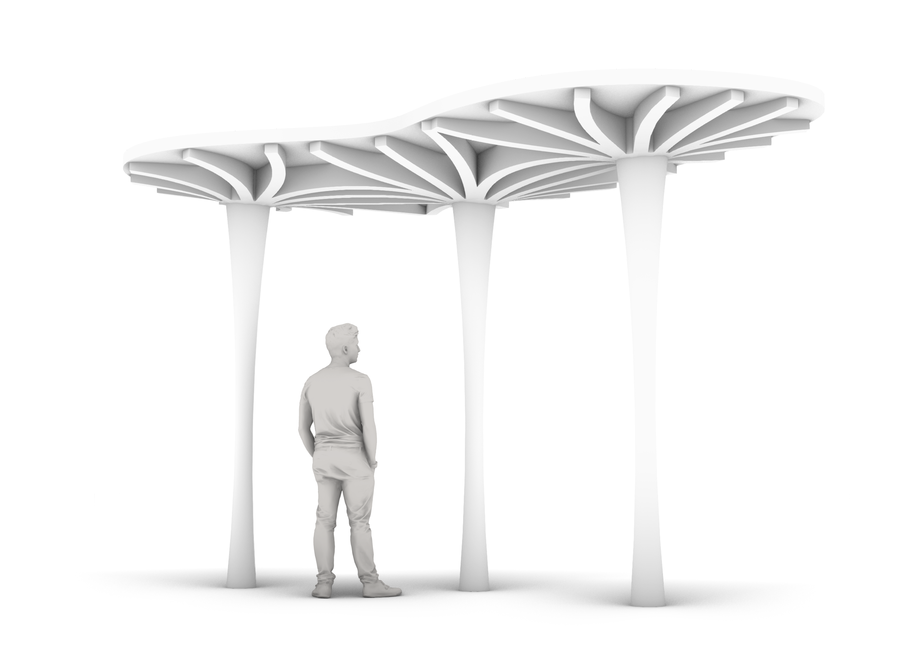
2022 Eggshell Pavilion
The 2022 Pavilion is intended as a demonstration of the possibilities in innovative, sustainable, reinforced concrete construction that can be achieved using the Eggshell technology. It will consist out of multiple prefabricated building components (columns, beams, slabs, etc.). The building components will be prefabricated in our Robotic Fabrication Laboratory at ETH Zurich and shipped to site.
The assignment for the MAS Students will be to produce a design that showcases the unique possibilities offered by the Eggshell process. Several companies have already agreed to act as a sponsor for materials. Currently, we are looking for a suitable site to develop the pavilion.
Contacts
Joris Burger (PhD Researcher)
burger@arch.ethz.ch
Dr. Petrus Aejmelaeus-Lindström (Postdoctoral researcher and MAS coordinator)
apetrus@arch.ethz.ch
Sketch of possible 2022 Pavilion
NOTE: DESIGN IS ONLY AN INDICATION, FINAL DESIGN CONCEPT OF THE PAVILION IS TO BE DECIDED BASED ON SITE, BUDGET, ETC.

Slide 4
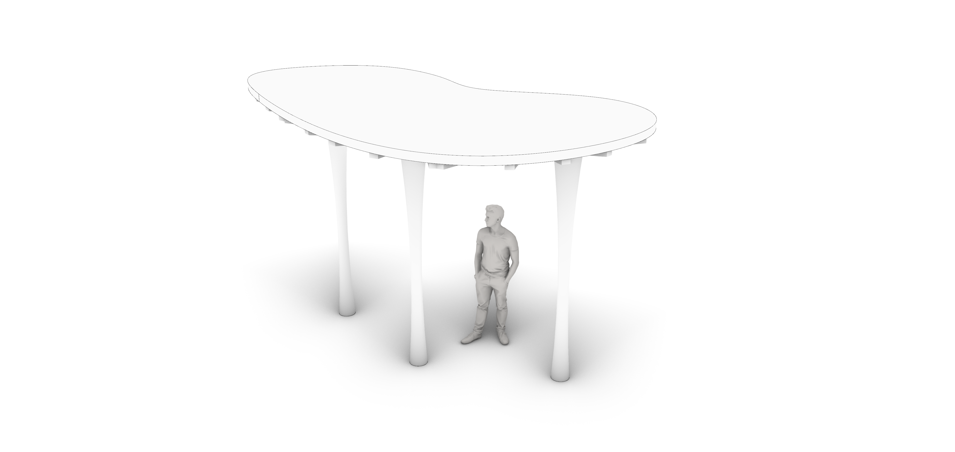
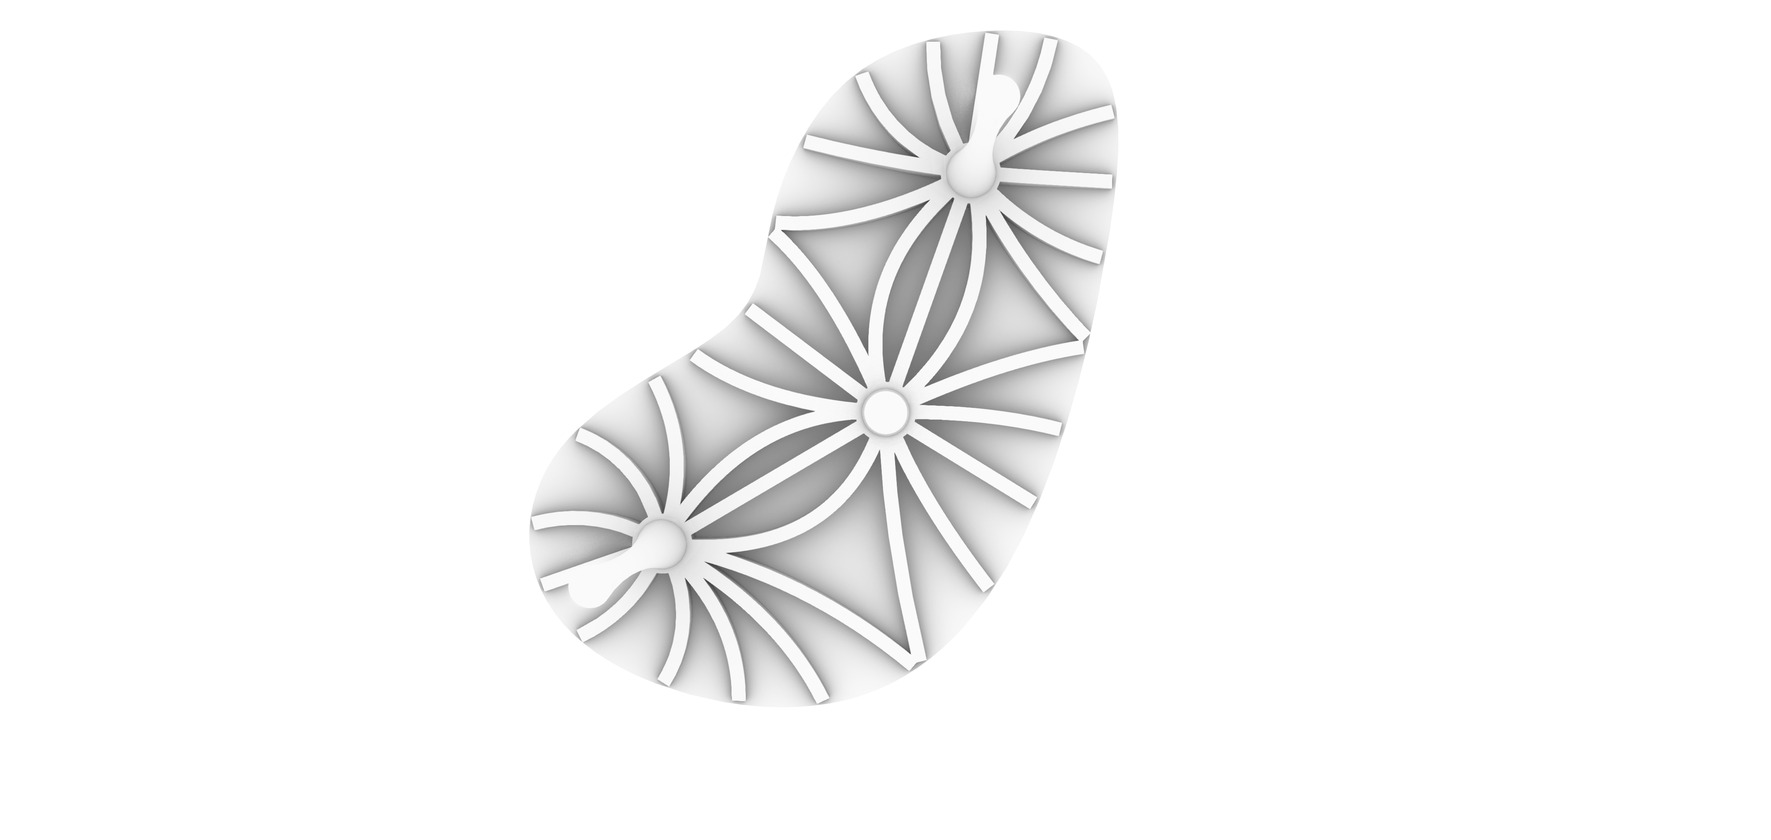
2022 Eggshell Pavilion
Sketch of possible 2022 Pavilion
NOTE: DESIGN IS ONLY AN INDICATION, FINAL DESIGN CONCEPT OF THE PAVILION IS TO BE DECIDED BASED ON SITE, BUDGET, ETC.

Slide 5
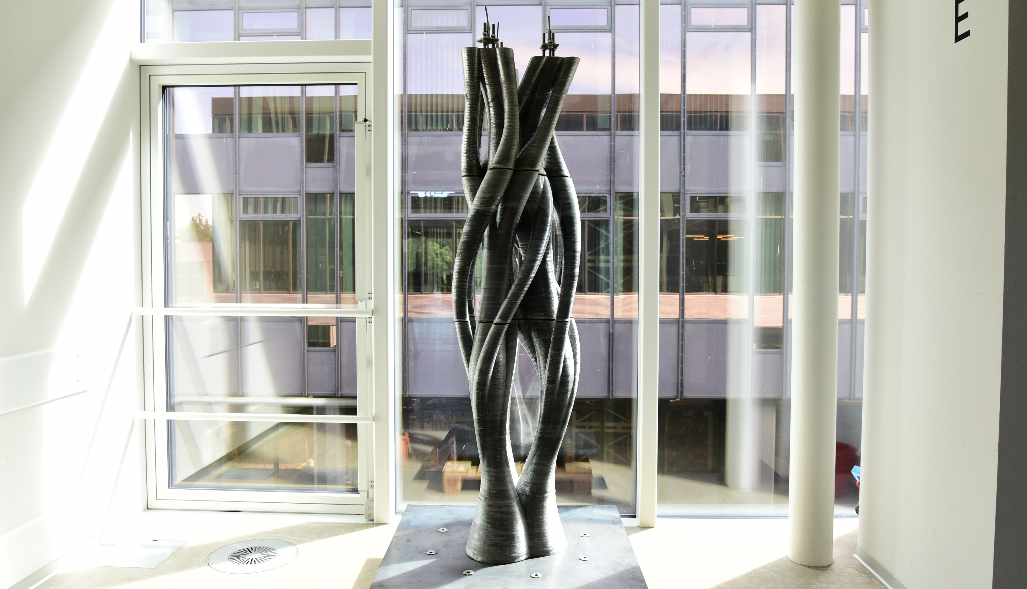
Twisting Column (2019)

Slide 6
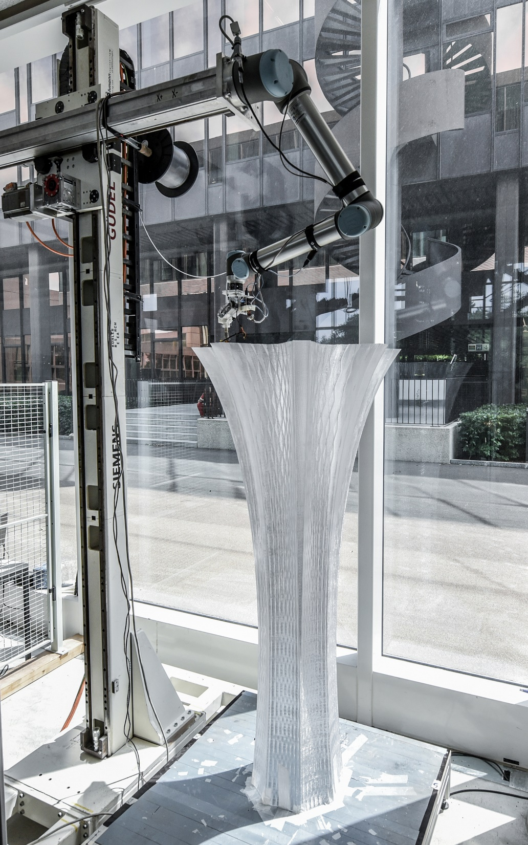
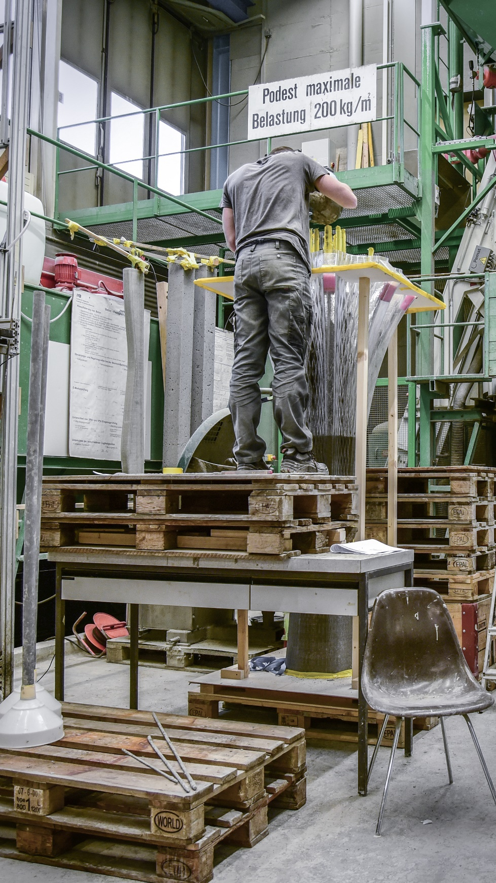
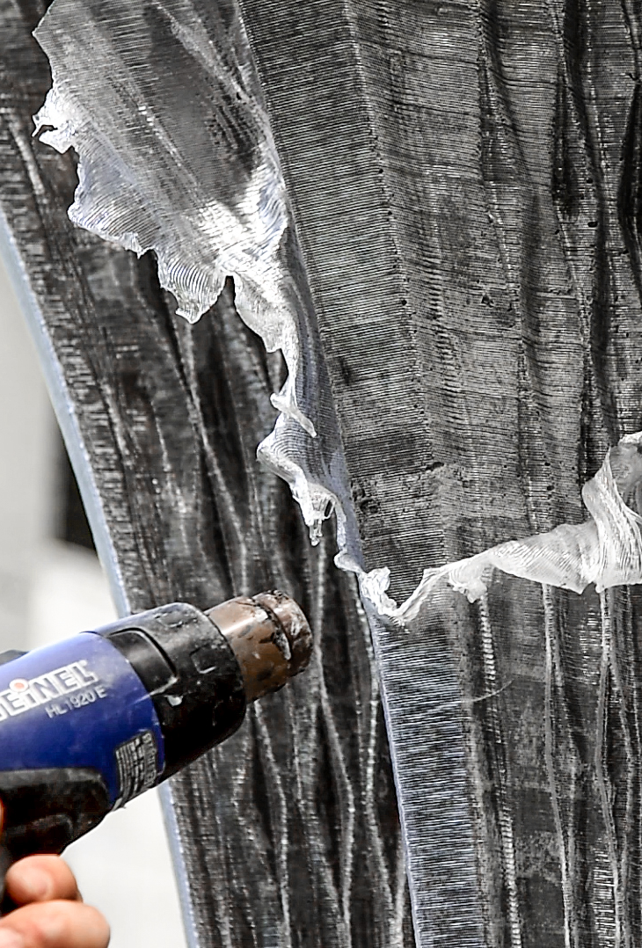
Future Tree (2019)

Slide 7
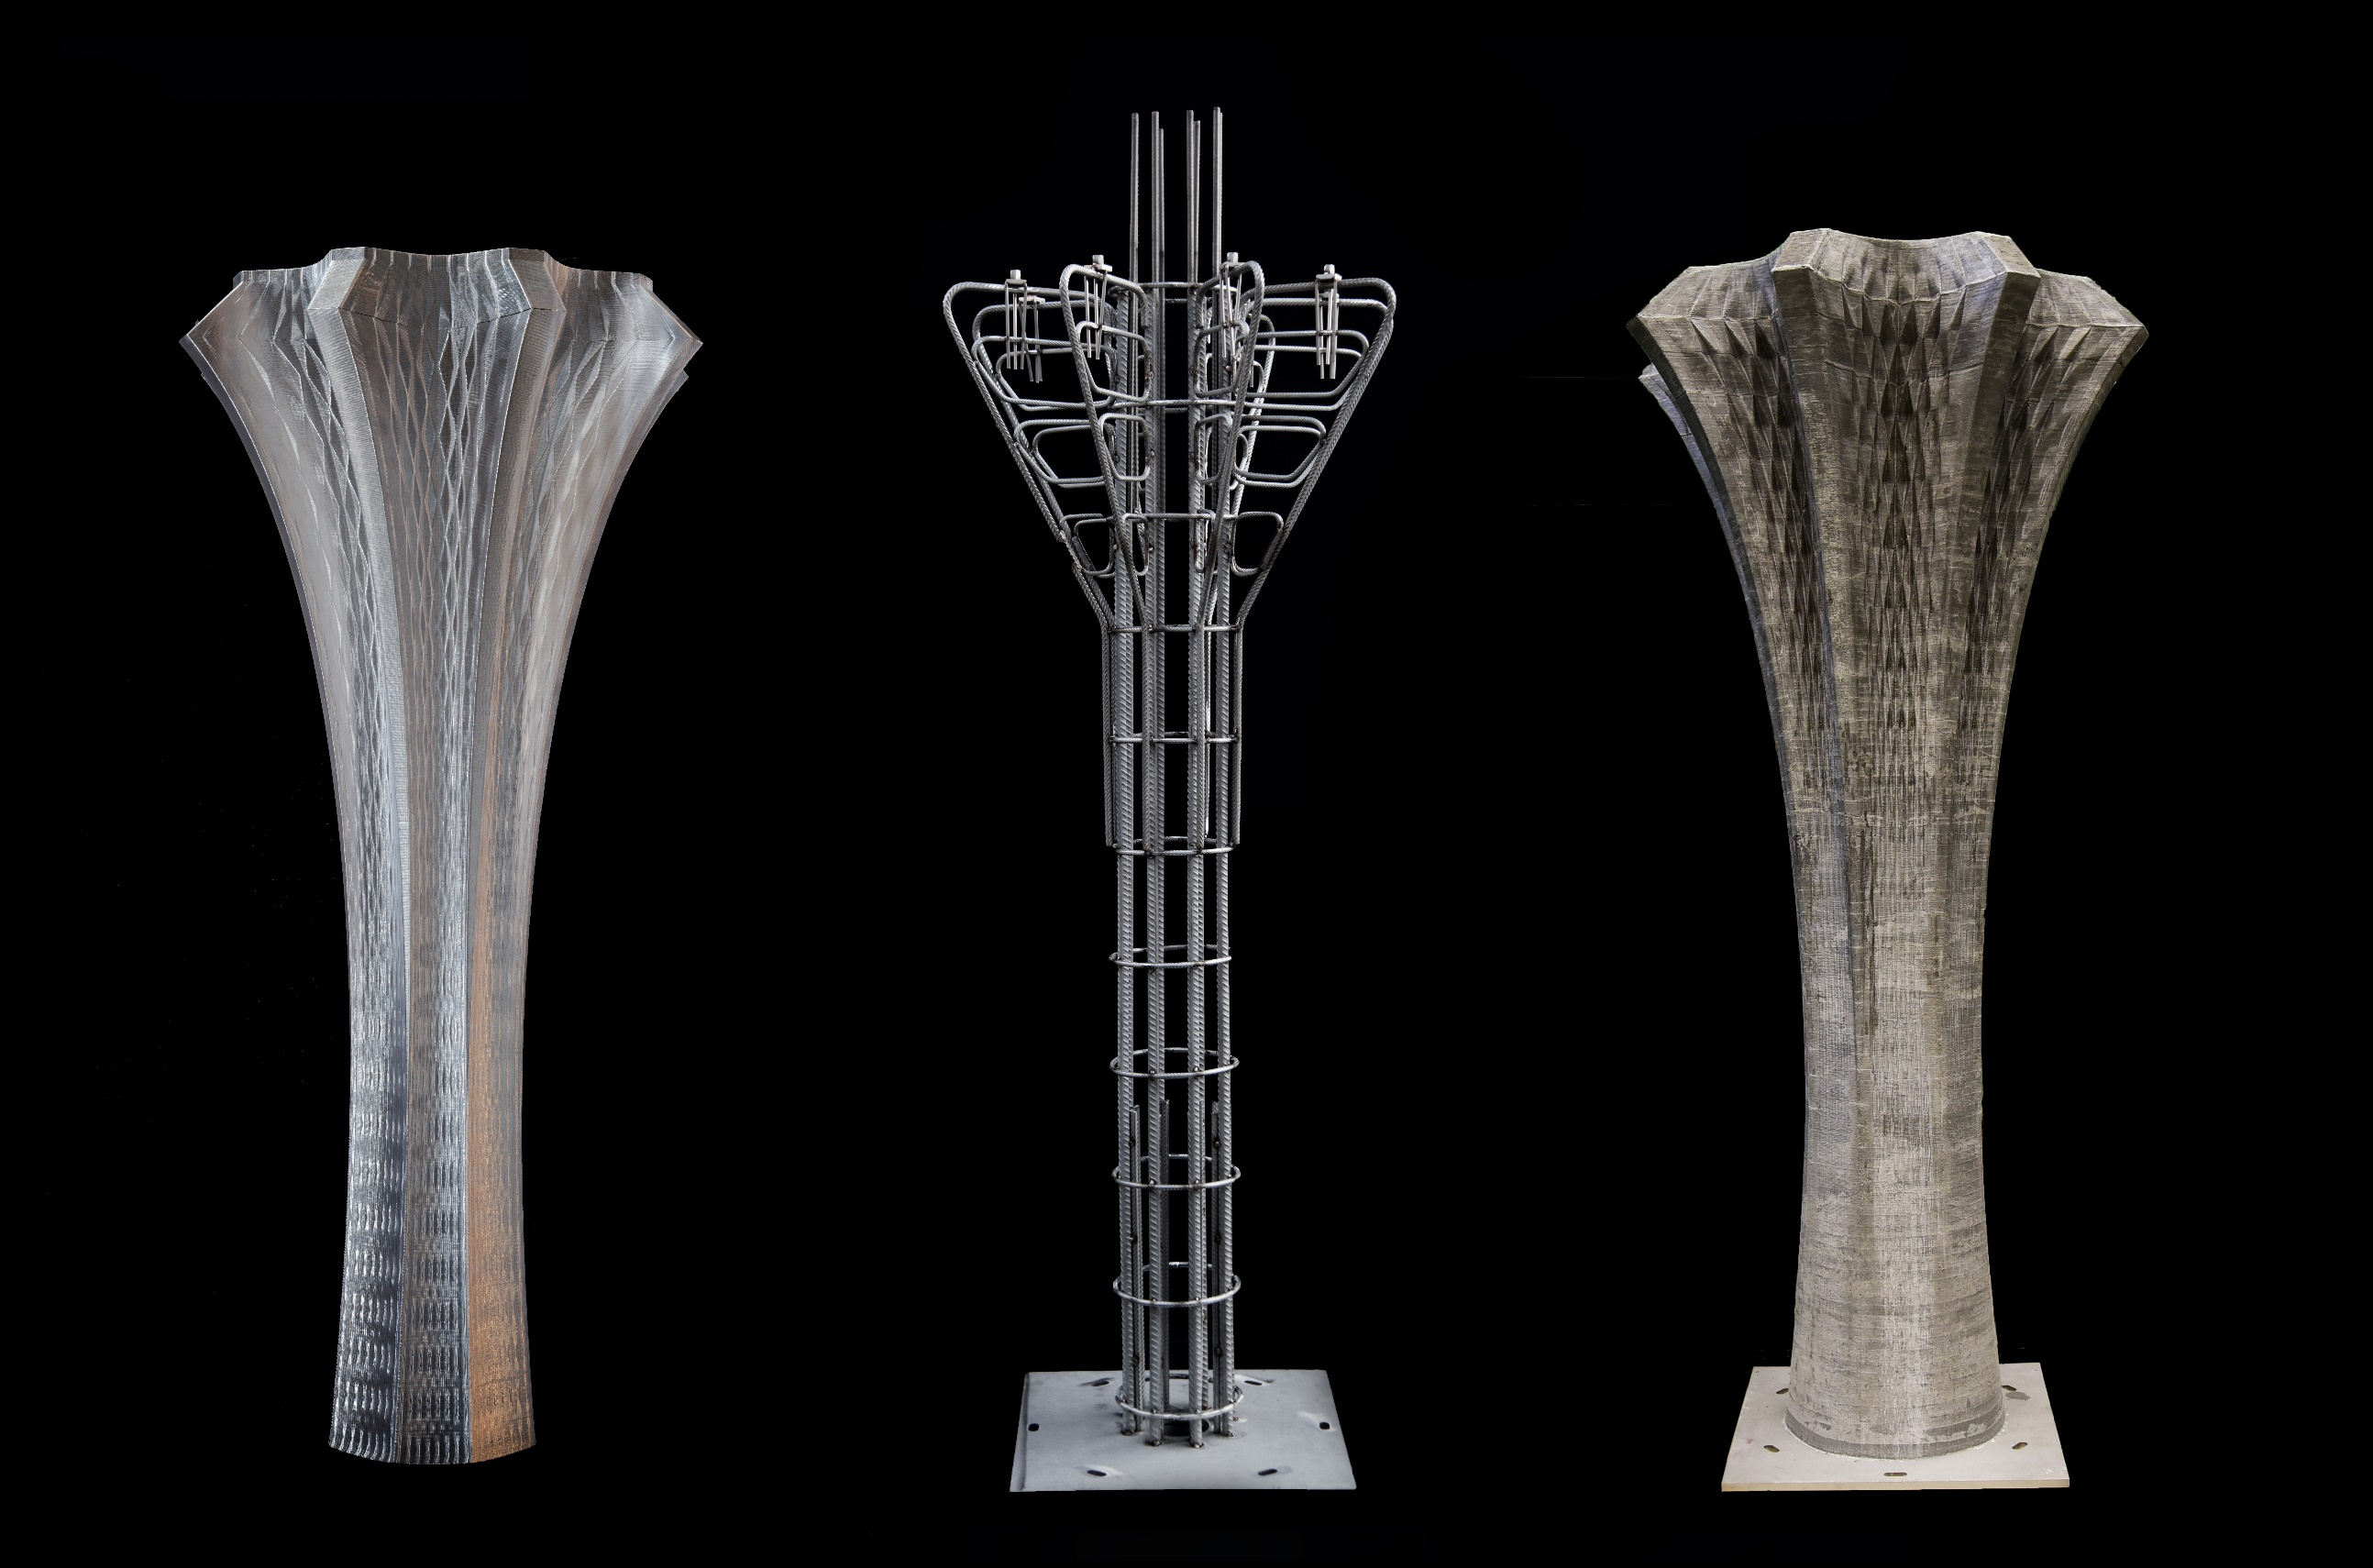

Slide 8
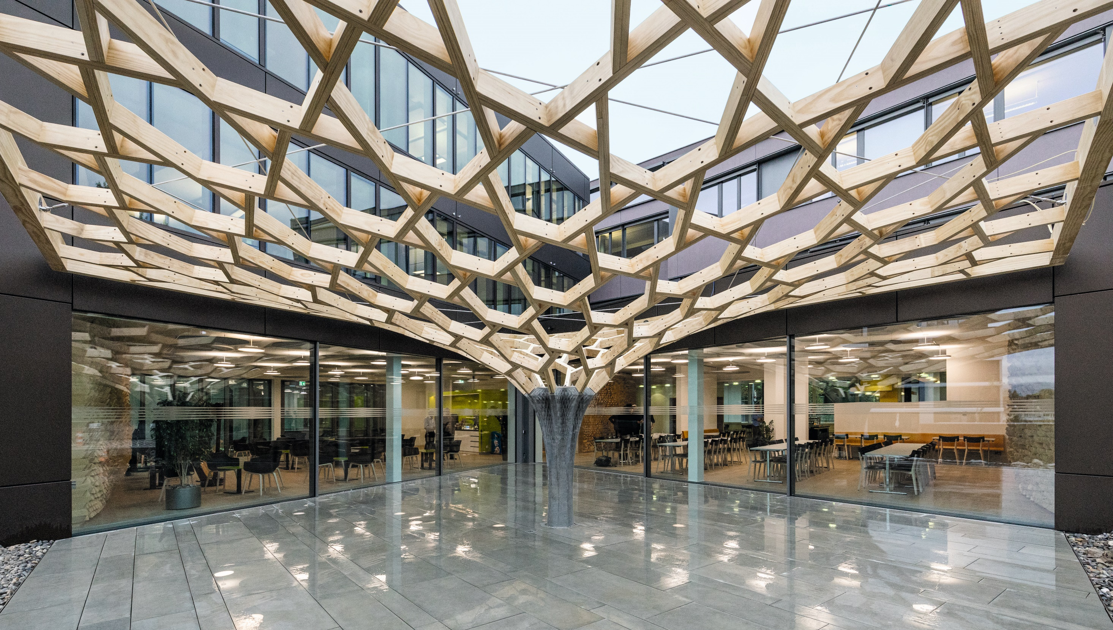

Slide 9
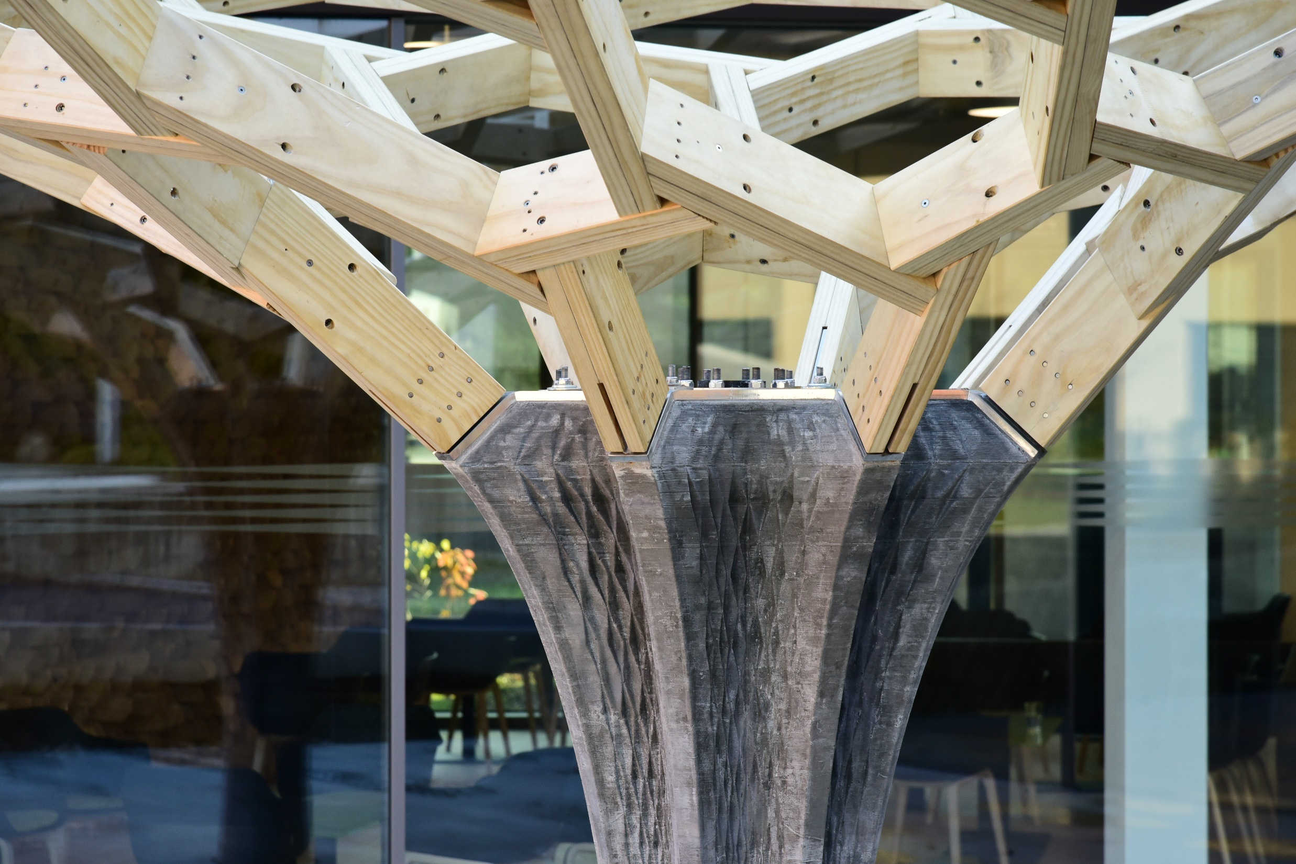

Slide 10
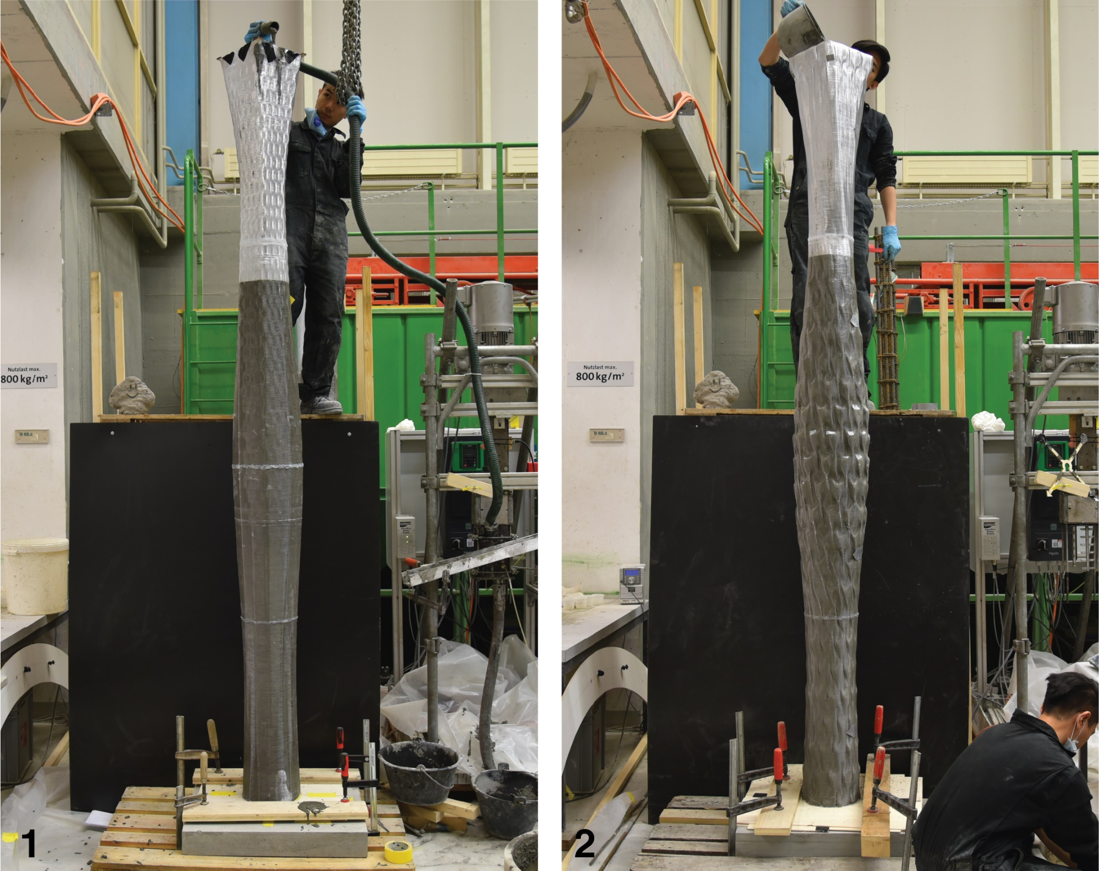
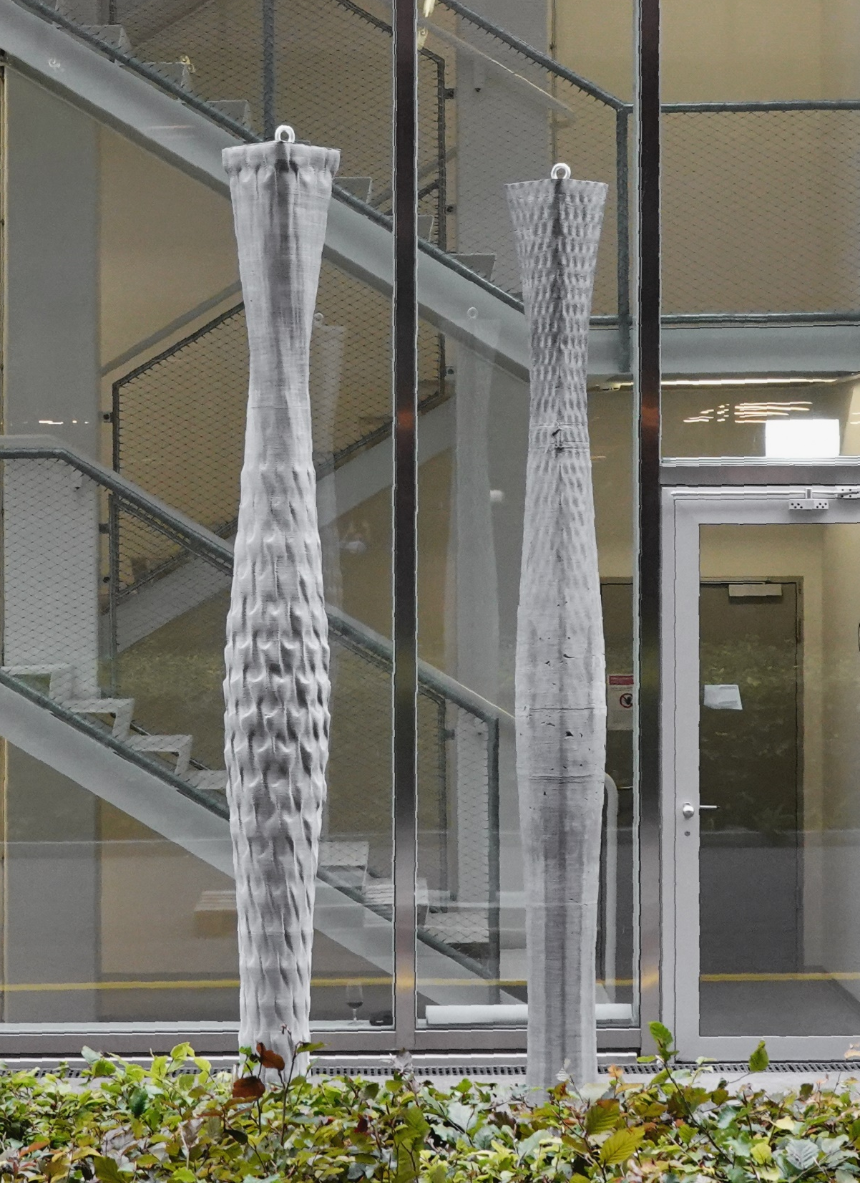
Material-Informed Column (2020)

Slide 11
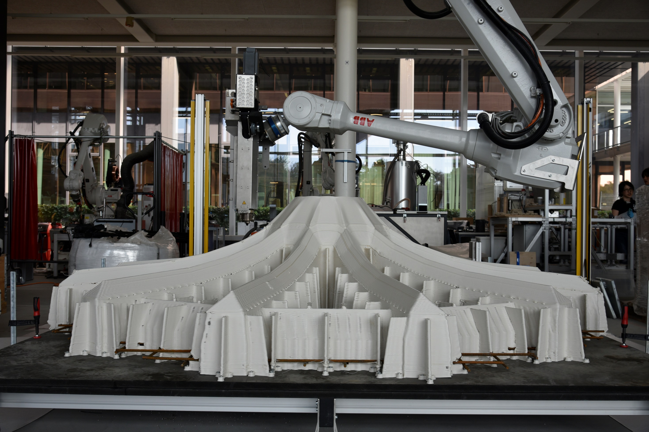
Optimized Ribbed Floor Slab (2021)

Slide 12
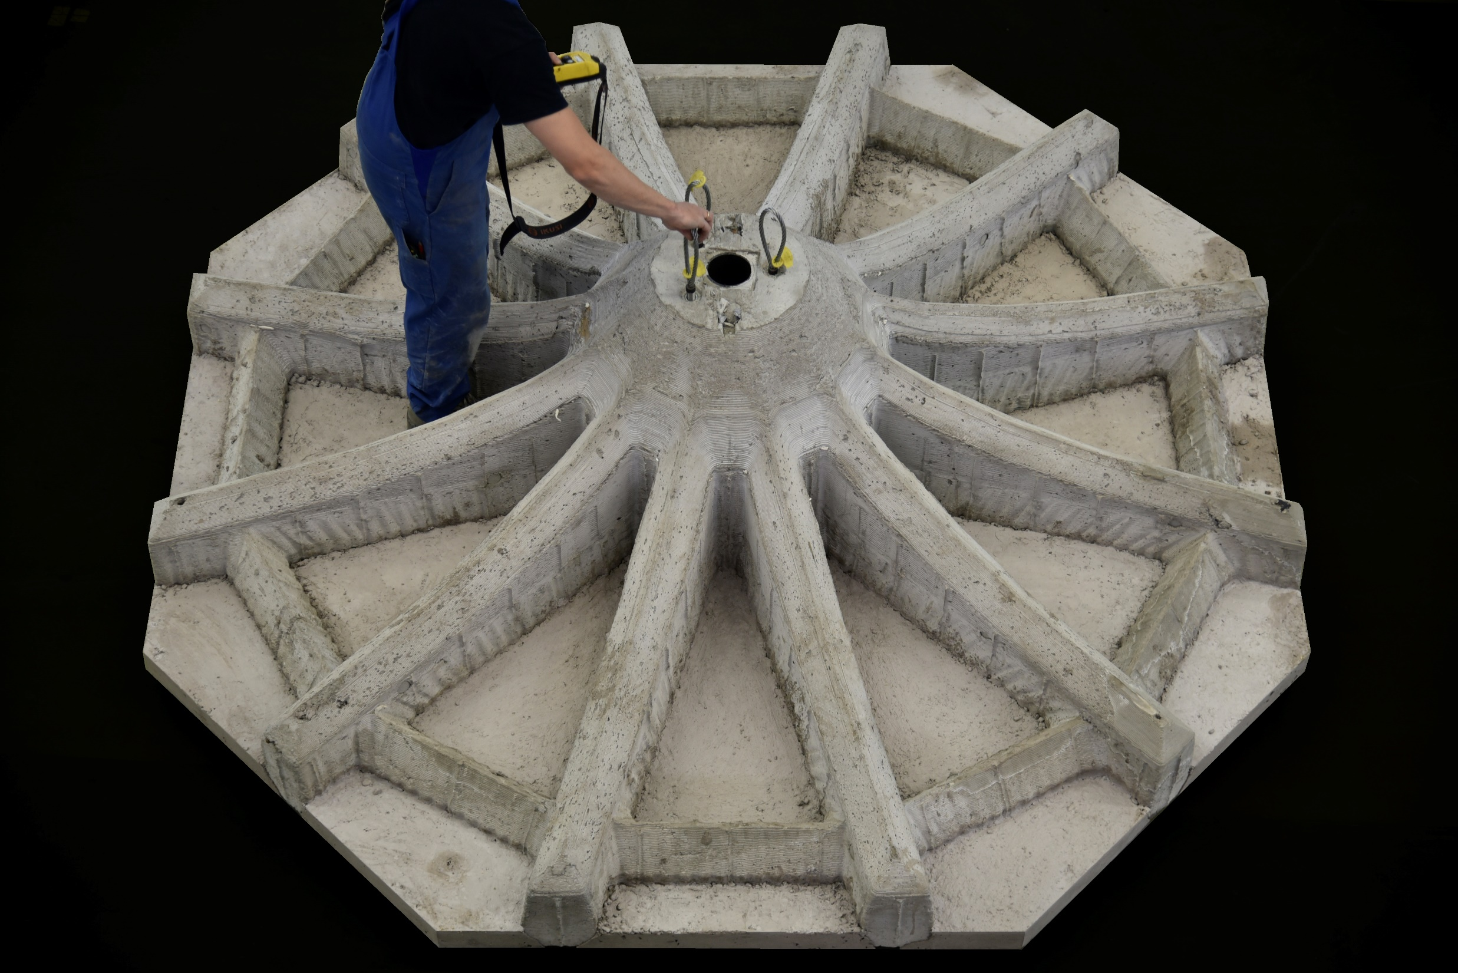
Optimized Ribbed Floor Slab (2021)

Slide 13
Selected previous MAS Pavilions
Robotic Pavilion (2016)
Gradual Assemblies (2018)
Concrete Choreograhpy (2019)
Up Sticks (2019)
Rapid Clay Formations (2020)

Slide 14
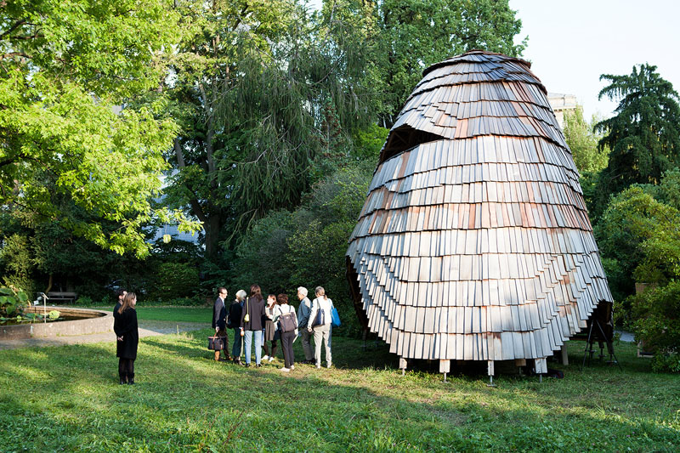
Robotic Pavilion (2016)
Botanical Gardens, Zurich, Switzerland

Slide 15
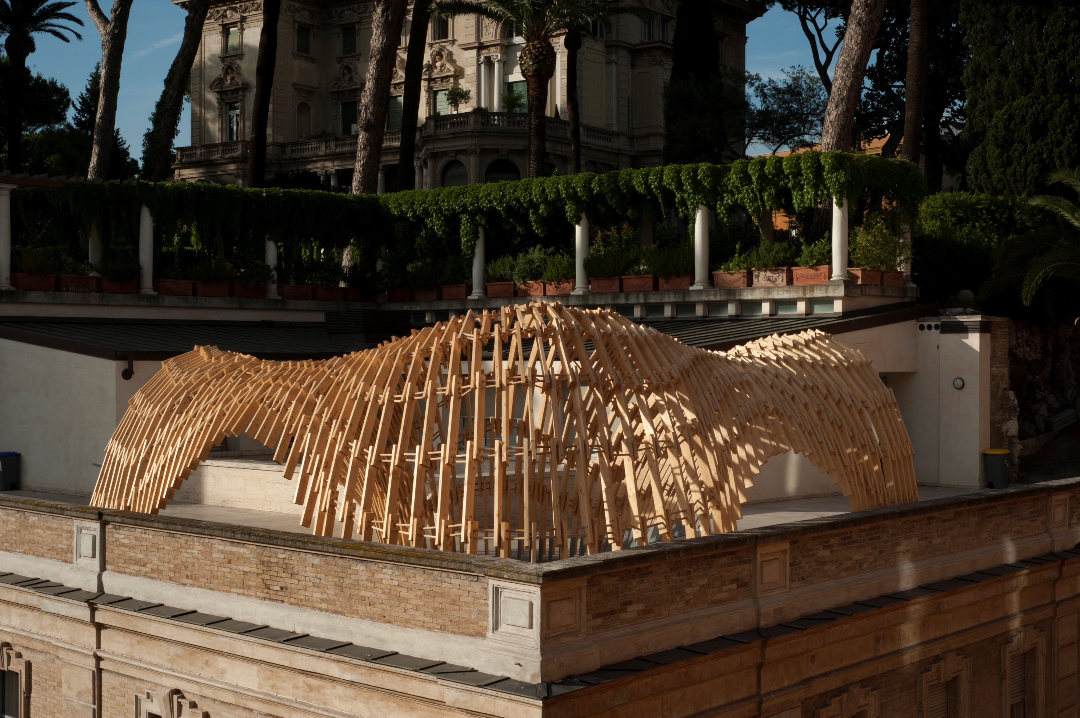
Gradual Assemblies (2018)
Istituto Svizzero, Rome, Italy

Slide 16
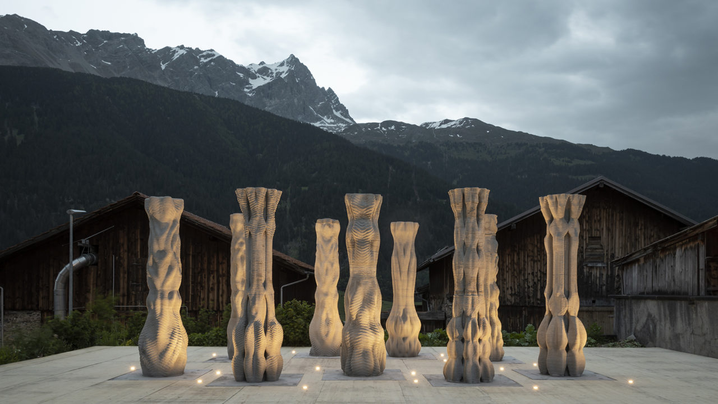
Concrete Choreograhpy (2019)
Origen Festival of Culture, Riom, Switzerland

Slide 17
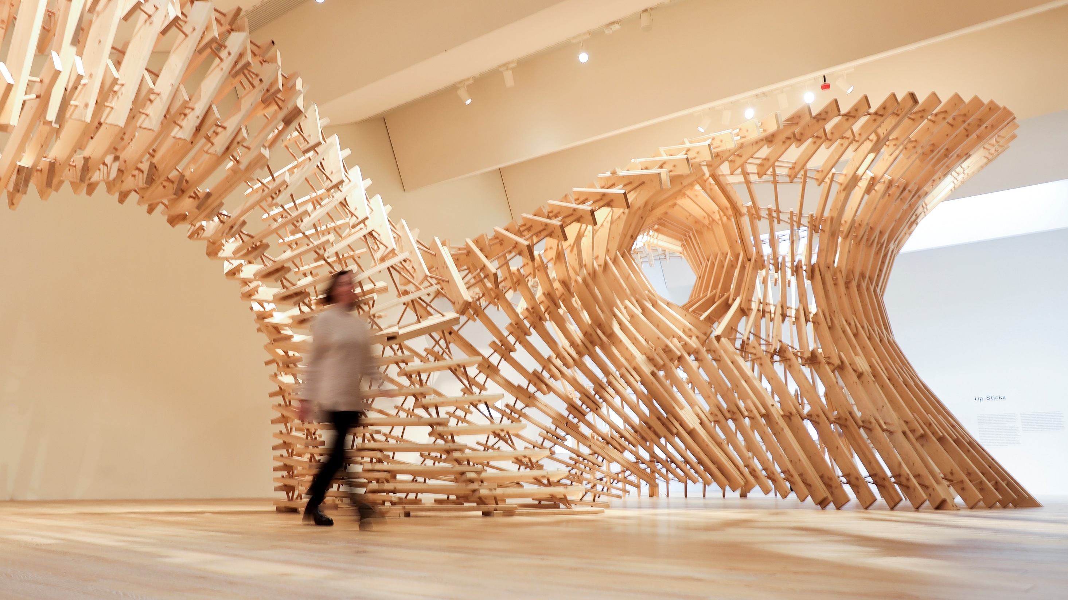
Up Sticks (2019)
Victoria & Albert Museum, Dundee, Scotland

Slide 18
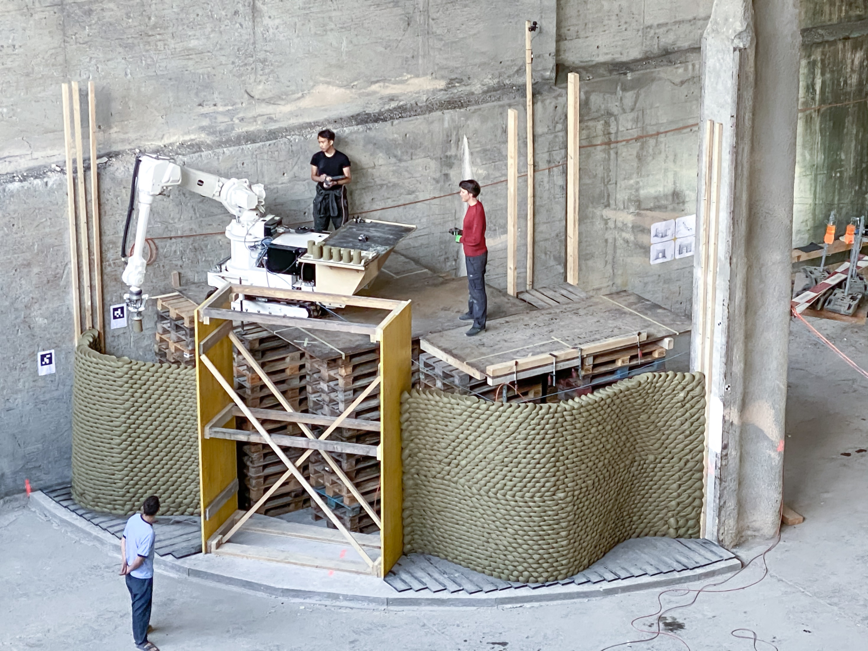
Rapid Clay Formations (2020)
Brunnen, Switzerland

